Slide 1
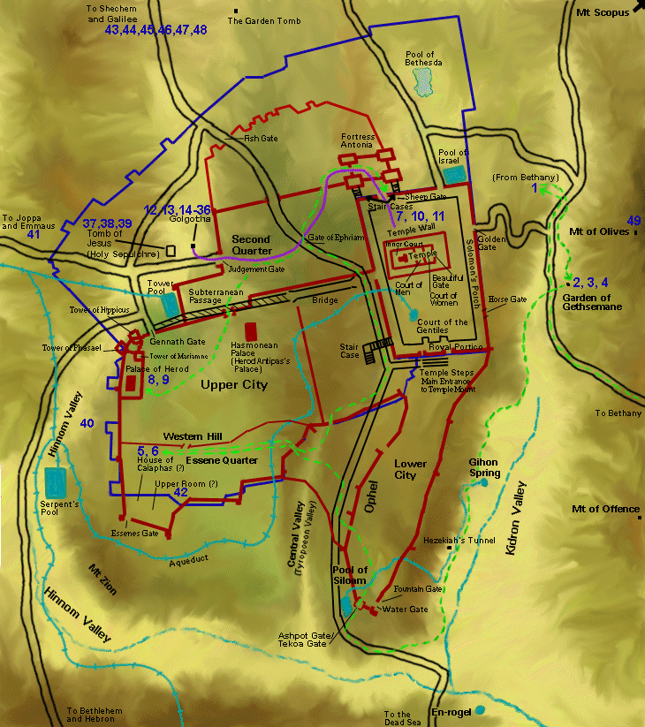
Jerusalem (AD 66)
The New City
Dr. Rick Griffith • Jordan Evangelical Theological Seminary • BibleStudyDownloads.org

Slide 2
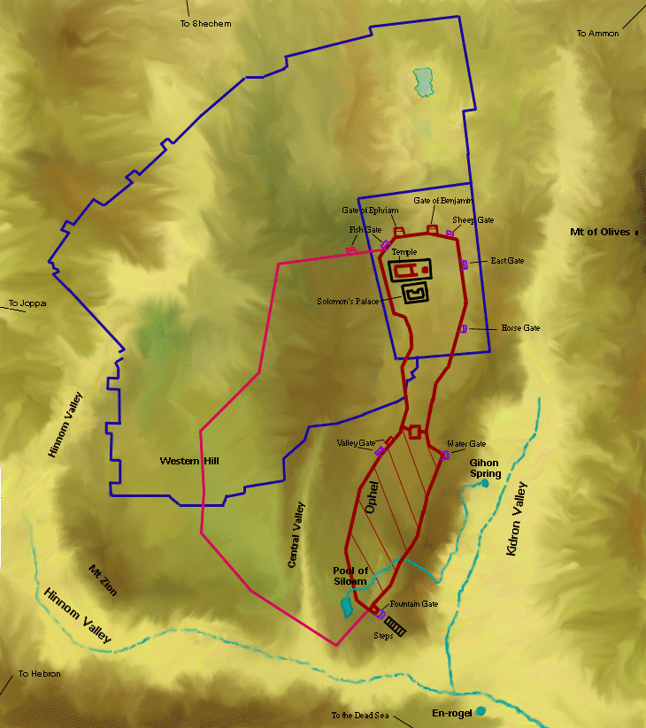
Jerusalem (700 BC)

Slide 3
Jerusalem in Jesus' Time

Slide 4
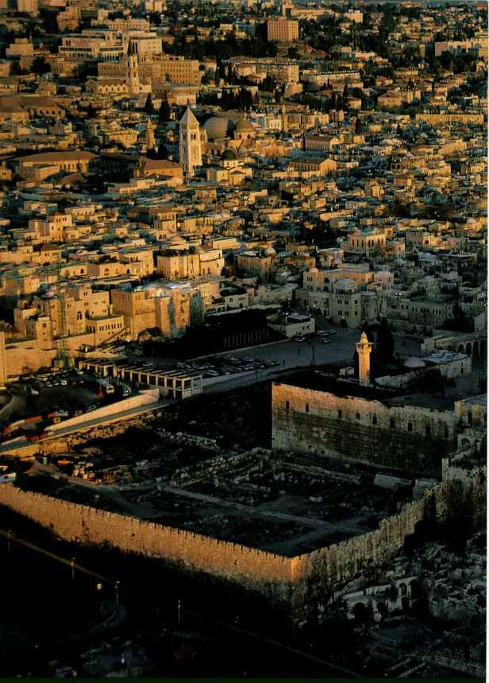
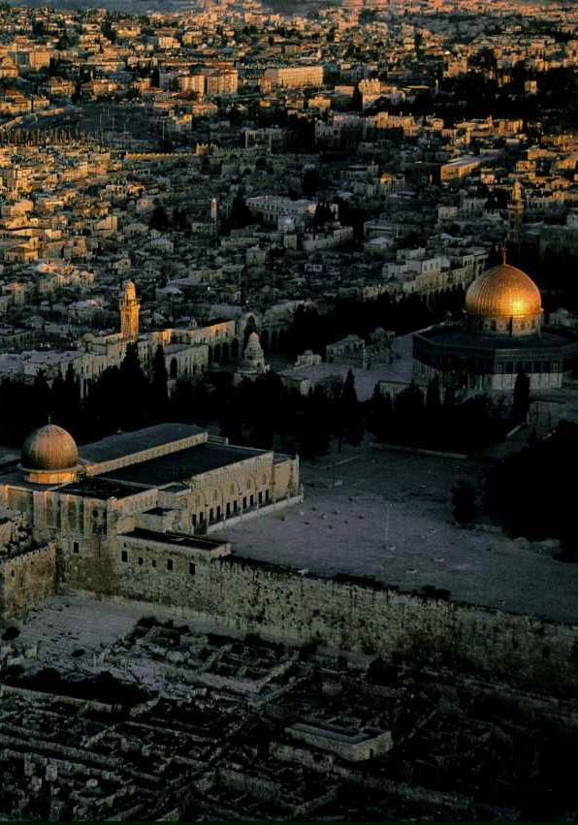
Temple Mount from the South

Slide 5
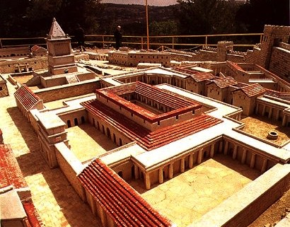
The House of Caiaphas

Slide 6
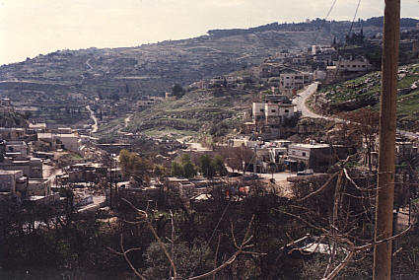
Akeldama (Field of Blood)

Slide 7
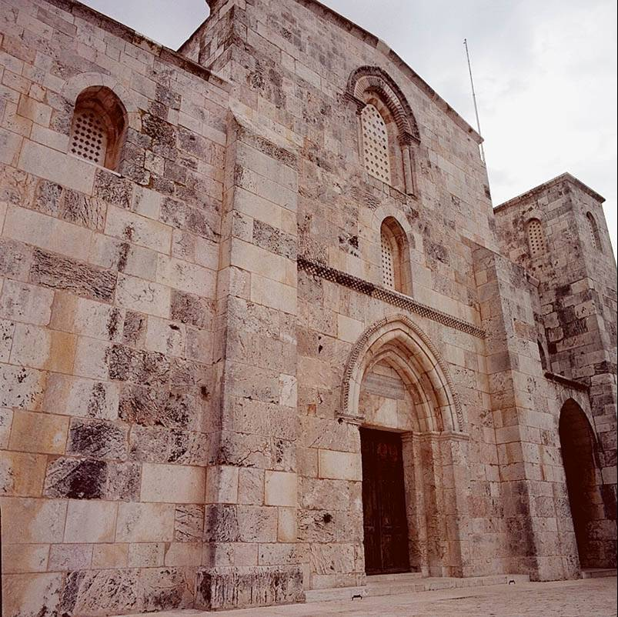
Zion Gate

Slide 8
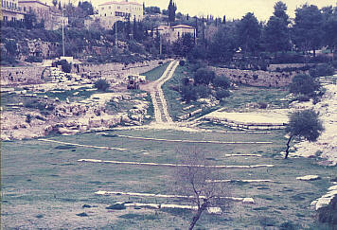
Hinnom Valley

Slide 9
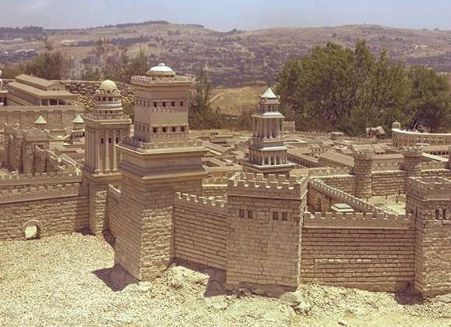
Herod's Three Fortress Towers (West)

Slide 10
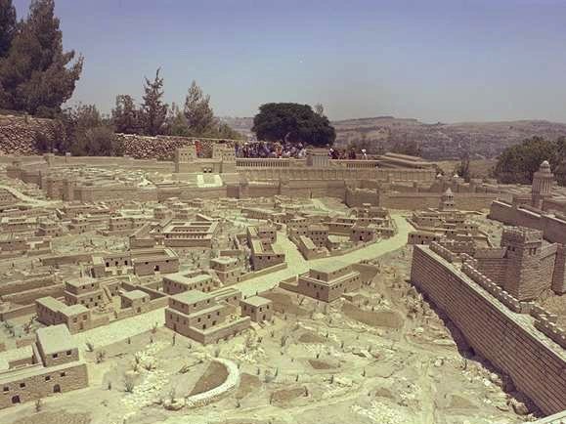
Northern Upper City Looking East

Slide 11
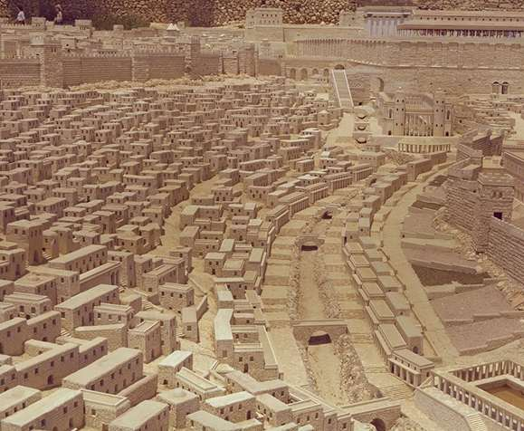
Lower City Facing North

Slide 12
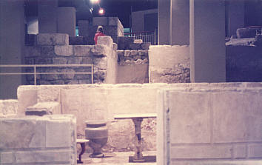
Herodian Quarter House

Slide 13
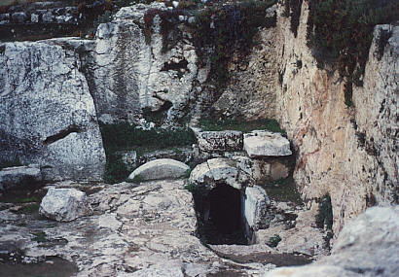
Herod Family Tomb

Slide 14
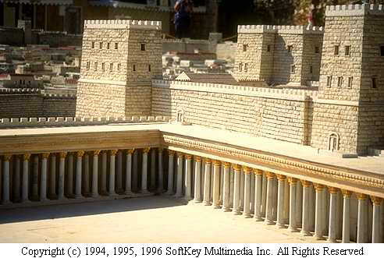
Antonia Fortress (North Temple Mount)

Slide 15
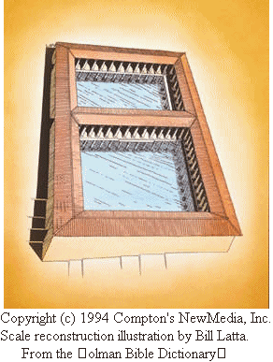
Pool of Bethesda
The Pool of Bethesda was a spring-fed pool near the Sheep Gate at Jerusalem, and was used by the sick for healing. Jesus healed a man there who had been stricken with an unidentified infirmity for thirty-eight years (John 5).
Scale reconstruction illustration by Bill Latta. From the Holman Bible Dictionary Copyright 1991. Holman Bible Publishers. All rights reserved. Used by permission.
Excerpted from The Complete Multimedia Bible based on the King James Version. Copyright (c) 1994 Compton's NewMedia, Inc.

Slide 16
Black

Slide 17
Bible Geography link at BibleStudyDownloads.org
Get this presentation for free!
Notes:
Bible Study (bs)

